Slide 1
NONLINEAR DYNAMICAL SYSTEM IDENTIFICATION FROM UNCERTAIN AND INDIRECT MEASUREMENTS
Selim Karaoglu
Hamideh Khaleghpour

Slide 2
Introduction to Nonlinear Dynamical Systems and Neuroscience
This presentation begins at the nexus of nonlinear dynamical systems and neuroscience, underscoring the pivotal role of precise modeling in deciphering the complex workings of the brain. We spotlight the formidable challenges posed by the analysis of fMRI data, notable for its indirect measurement techniques and vulnerability to noise.
This project advocates for the adoption of sophisticated analysis methodologies to navigate the intricacies of brain activity data, setting a robust foundation for the exploration that follows.

Slide 3
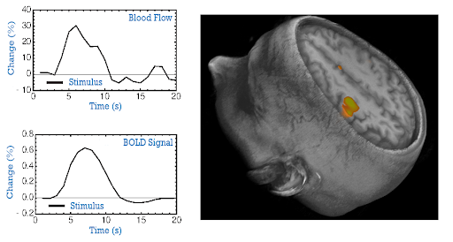
Understanding fMRI Data
FMRI data is typically associated with brain imaging and would be an application area for the discussed techniques, especially in understanding brain dynamics from noisy and indirect measurements.
Functional MRI (fMRI) is pivotal in mapping brain activity by detecting changes in blood flow.
However, the BOLD signal provides an indirect measure of neural activity, presenting unique challenges such as significant noise and the complexity of interpreting high-dimensional data.

Slide 4
Goals of the Project
This project aims to leverage nonlinear system identification techniques, focusing on the Unscented Kalman Filter, to enhance modeling and understanding of neural dynamics from fMRI data, addressing the direct challenges of noise and indirect measurement.

Slide 5
Unscented Kalman Filter (UKF)
The Unscented Kalman Filter represents an advancement in filtering technology, adept at handling nonlinearities in data without necessitating linear approximations, making it particularly suited for the complex and noisy data characteristic of fMRI.
KF | EKF | UKF
Linear state space models. Gaussian random variables. x_{t+∆t} = F(x_{t}) | Taylor expanded up to a given order. Expectations are taken to compute the updated mean and covariance. x_{t+∆t} ≈ F(x_{t}), P_{xx,t+∆t} ≈ ∇F(x_{t}) P_{xx,t}(∇F(x_{t}))′ | Retains the exact nonlinearity of F but approximates the a posteriori probability density of the state x_{t+∆t} by a Gaussian. x_{t+∆t} ≈ F(x_{t}) + (∇′P_{xx,t}∇/2) F(x_{t}), P_{xx,t+∆t} ≈ ∇F(x_{t}) P_{xx,t}(∇F(x_{t}))′ More accurate for nonlinear systems, and computationally much simpler to implement.

Slide 6
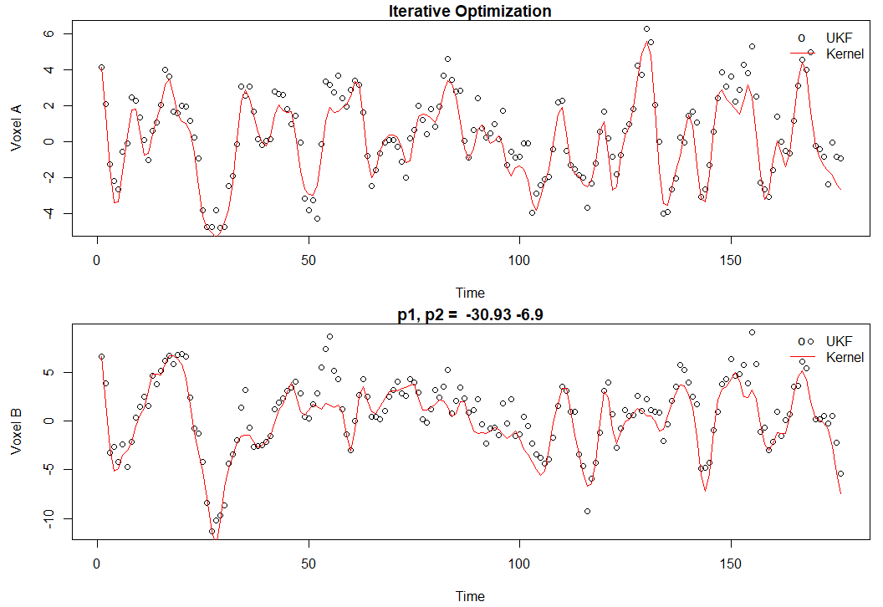
UKF Application to fMRI Data
The application of UKF to fMRI data has demonstrated significant improvements in modeling accuracy, providing deeper insights into brain activity patterns and enhancing our ability to interpret complex neural signals.

Slide 7
Conclusion and Future Directions
UKF on different fMRI signals (different regions, different subjects)
Coupled oscillator model modification
Parameter estimation methods comparison
Measuring coupling on more than 2 regions simultaneously

Slide 8
Thank you

